Slide 1

Health Based Food Recommendation System using ML
Presented by:
Subodh R. Tirpude-([Section-A] [Roll No.-73])
Chandan M. Mujumdar-([Section A] [RollNo.-36.])
Sumit S . Jade-([Section-A] [Roll No.-28])
Saurav U. Hingade-([Section] [Roll No.-26])
Guided by:
Mr. C . R . Ingole
Prof Ram Meghe College of Engineering and Management Badnera-Amravati
Department of Computer Science and Engineering
2023-24

Slide 2
Content
Implementation
Code Demonstration
References

Slide 3
CORRECTIONS SUGGESTED BY JUDGES IN PRESENTATION-1
Region wise food recommendation
Recommendation according to veg / Non – veg
User Friendly GUI
Dataset
Parameters (BMR , Lifestyles )

Slide 4
implementation
Region wise food recommendation
Model take the region as a input from the user and recommend the food based upon the region from which user belongs.
Recommendation according to veg / Non – veg
It will ask the user for veg and non veg category and recommend the food accordingly

Slide 5
implementation
Parameters (BMR , Lifestyles )
We will use the two more extra parameters i.e BMR and activity level for more accurate recommendation
Dataset
We also have made some change in dataset and made it more optimize for faster processing for worldwide food recommendation
User Friendly GUI
we have created user friendly GUI that is easy to learn and use even for people with no prior experience

Slide 6
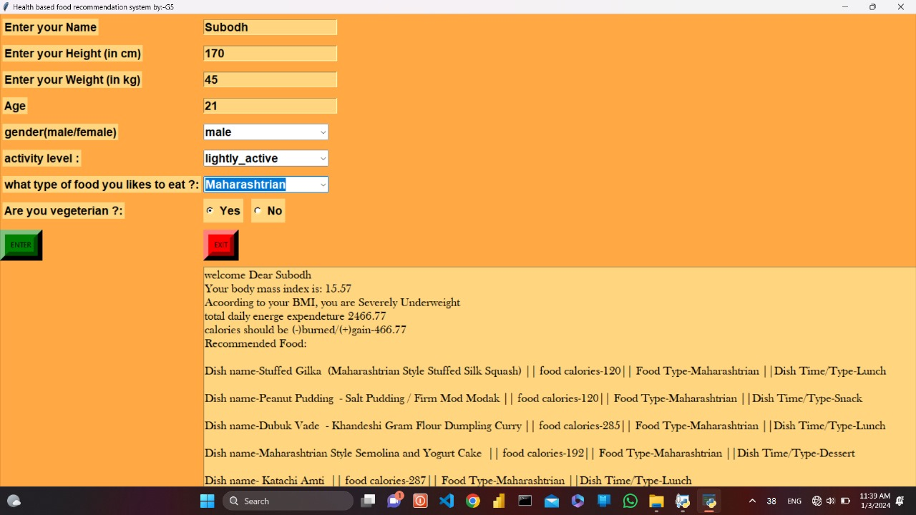

Slide 7
Code Demonstration

Slide 8
References (APA Format)
1) Mifflin MD, St Jeor ST, Hill LA, Scott BJ, Daugherty SA, Koh YO. A new predictive equation for resting energy expenditure in healthy individuals; The American Journal of Clinical Nutrition; February 1990
2) Harris JA, Benedict FG. A Biometric Study of Human Basal Metabolism.; The Proceedings of the National Academy of Sciences (PNAS); 1918
3) McArdle WD, Katch FI, Katch VL. Exercise Physiology – Energy, Nutrition and Human Performance.; Journal of Physical Therapy Education; 2001
4) Schofield WN. Predicting basal metabolic rate, new standards and review of previous work; Human nutrition : Clinical nutrition; 1985
5) Roza AM, Shizgal HM. The Harris Benedict equation reevaluated: resting energy requirements and the body cell mass.; The American Journal of Clinical Nutrition; July 1984
6) Mrs. N. Naga Lakshmi, M. Jagadeesh Reddy, K. Hari Krishna, S. Sindhuja Reddy. Vitamin Deficiency and Food Recommendation System Using Machine Learning.; International Journal for Research in Applied Science & Engineering Technology (IJRASET);
[7] Shubham Singh Kardam, Pinky Yadav, Raj Thakkar, Prof Anand Ingle, “Website on Diet Recommendation Using Machine Learning”, International Research Journal of Engineering and Technology (IRJET), vol.8, 2021, p-ISSN: 2395-0072.
[8] Salliah Shafi Bhat and Gufran Ahmad Ansari, “Predictions of Diabetes and Diet Recommendation System for Diabetic Patients using Machine Learning Techniques”, International Conference for Emerging Technology (INCET), 2021, Belagavi, India, pp. 1-5, doi: 10.1109/INCET51464.2021.9456365.
[9] S. V. N. Sreenivasu, Sakshi Gupta, Ghanshyam Vatsa And Anurag Shrivastava, “Carbohydrate Recommendation for Type-1 Diabetics Patient Using Machine Learning”, 5th International Conference on Contemporary Computing And Informatics, UP, 2022, pp. 600-604, doi: 10.1109/IC3I56241.2022.10072919.
[10] Aryan Jalali, Kumar P. Arjun Manoj, N.Amulya, Ayesha Siddiqui, Alok Kumar Singh, S.M. Hari Krishna, “Mobile Application for Personalized Food Recommendation”, IEEE 7th International Conference for Convergence in Technology, Mumbai, 2022, pp. 1-6, doi: 10.1109/I2CT5491.2022.9824896.
[11]George A Bray, William E Heisel, Ashkan Afshin, Michael D Jensen, William H Dietz, Michael Long, Robert F Kushner, Stephen R Daniels, Thomas A Wadden, Adam G Tsai, Frank B Hu, John M Jackicic, Donna H Ryan, Bruce M Wolfe, Thomas H Inge, “The Science of Obesity Management: An Endocrine Society Scientific Statement”, Endocrine Reviews, 2018, vol: 39, doi: https://doi.org/1

Slide 9


